Slide 1
Sierra Wireless
Sierra Wireless is building a leading portfolio for the Internet of Things including:
Embedded solutions
Gateway solutions
Cloud and connectivity services.
Advantages:
Simple, scalable, and secure
Enabling businesses to bring innovative products and services to market faster and at a lower cost.

Slide 2
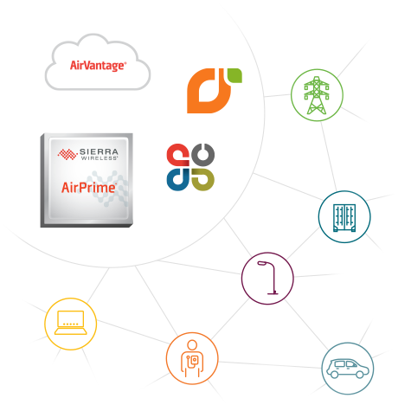
Embedded Solutions
Our embedded solutions deliver a future-proof 2G, 3G, 4G device-to-cloud architecture for building connected products. For OEMs and System Integrators, we take the complexity out of adding wireless so you can develop, deploy, and maintain your connected products and services for years in the field.
As the number one cellular module vendor in the world for the fourth straight year, we are committed to delivering innovative solutions to OEMs and System Integrators that help reduce overall system complexity and get you to market faster. From connecting vehicles, industrial assets, or homes, to helping you launch new revenue-generating services that deliver more user value, our embedded portfolio provides a simple, scalable, and secure way to add wireless to any IoT application.

Slide 3

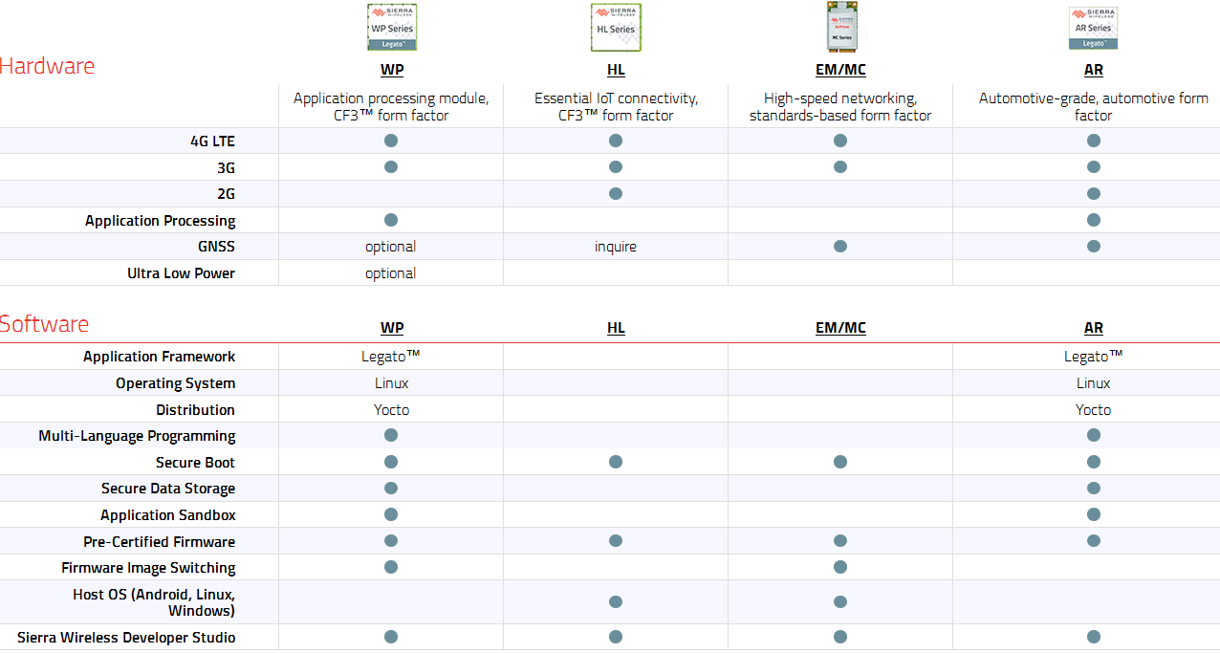

Slide 4
SerriaWireless Products
Product Type | AirPrime AR and WP series | FXT and GL series | Airlink modem
 | Sim (smsInboxService ,…) | Sim (smsInboxService ,…) | SMS
 | Communication UART | Communication UART | Communication UART
 | voiceCallService | GMS/GPRS | GPS
 | audio (record or playback,digital or analog) | audio | audio
 | CAN interface |  | GPIO
Features can be Tested | Communication I2C, I2S,SPI... | Communication I2C, I2S,SPI... | Communication I2C, I2S,SPI...
 | RF Antenna | FME Antenna
 | Position (GPS,GNSS)
 | ADC or DAC | ADC or DAC
 | GPIO | GPIO
 | Connect data 2G,3G,4G | Connect data 2G,3G,4G | Connect data 2G,3G,4G

Slide 5
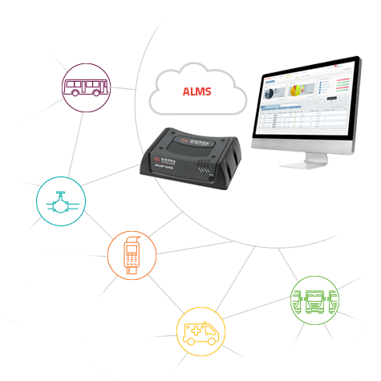
Gateway Solutions
We offer a range of intelligent gateways, management tools, and services that allow organizations to keep remote workers and assets connected to the enterprise for mission-critical deployments. Our solutions provide persistent connectivity, location-based services, and remote monitoring, to increase productivity and improve customer service.
AirLink® gateways connect your remote organizational assets – people, locations and infrastructure – securely to the enterprise, and allow you to remotely monitor and manage these assets. They can be deployed out-of-the-box with no programming required and are built with the intelligence to always stay connected. Relied upon every day in remote outdoor locations, in-vehicle applications, and retail chains, they securely connect people, equipment, and services.

Slide 6

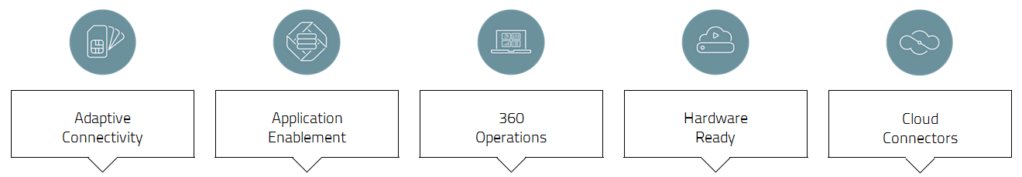
Cloud and Connectivity Services
We offer a range of intelligent gateways, management tools, and services that allow organizations to keep remote workers and assets connected to the enterprise for mission-critical deployments. Our solutions provide persistent connectivity, location-based services, and remote monitoring, to increase productivity and improve customer service.

Slide 7
Sagemcom GSM-R Solutions
Designed for GSM-R cab radios to deliver mission-critical railway communications
Sierra Wireless GSM-R products for the railway industry include Mobile Radio Modules (MRM) and handheld mobile terminals for GSM-R wireless communications over private railway cellular networks.

Slide 8
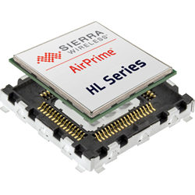
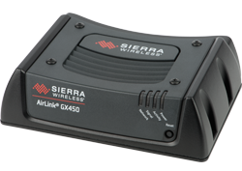
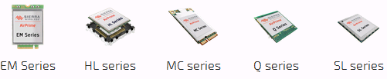
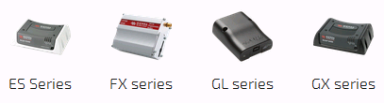
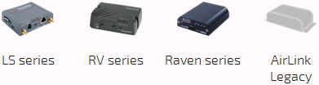


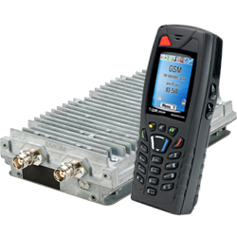
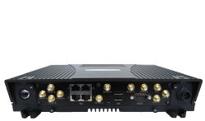

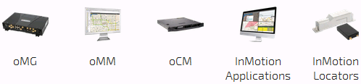
SierraWireless Devices
AirLink gateway & Routers
AirPrime modules: EM Series, HL, MC, Q, SL, WMP, WP, WS, XM Extention card
GSM-R: Modems and terminals for railways.
MRM Series, Handsets

Slide 9
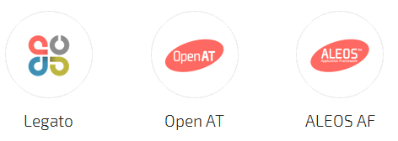
Embedded SW Platforms
AirVantage
Legato: Open source embedded platform built on Linux. AirPrime WP and AR series board
Open AT Application Framework: FXT and GL series
ALEOS AF: AirLink modems are highly configurable and can be scripted using the ALEOS Application Framework (AAF) to gather IoT data.
Not Hosted OS

Slide 10


Development Kits
AirPrime EM Series Development Kit
AirPrime HL Series Development Kit
AirPrime MC Series Development Kit
AirPrime SL Series Development Kit - Full Accessories
M2M Modules

Slide 11
M2M Modules
AirPrime EM7355 Module
AirPrime HL6528 Module
AirPrime HL6528-G Module (with GLONASS support)

Slide 12
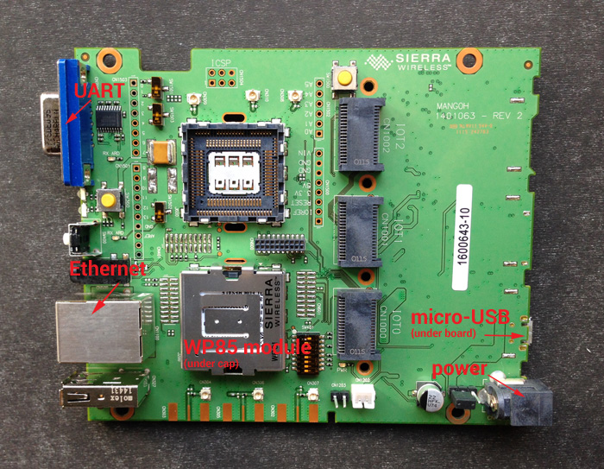
Project mangOH™ Open Hardware
Project MangOH™ is an open hardware initiative to enable rapid prototyping and faster time-to-market of new IoT devices and applications.
Designed to fit in a Euro card standard
size casing (120mm x 100mm), additional
hardware specs include:
1 USB 2.0 OTG
1 USB 2.0 Host
1 RS232/Serial
1 RJ45/Ethernet
Audio Jack
SD card
3 SMA antenna connectors
(Primary, Secondary/Diversity, GPS)
Accelerometer, Gyroscope
Battery/Battery Charging

Slide 13
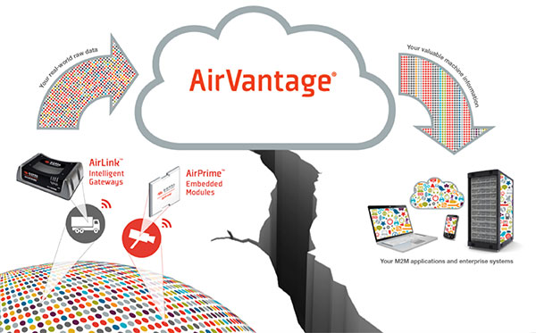
Cloud
AirVantage Platform
AirLink Management Service
AirVantage Platform FOTA Edition
AirLink Enterprise Connect

Slide 14
Maestro uses AirPrime® modules for global coverage in a single, compact footprint

Slide 15
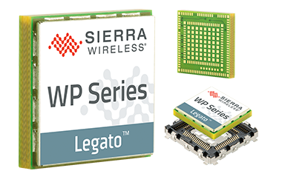
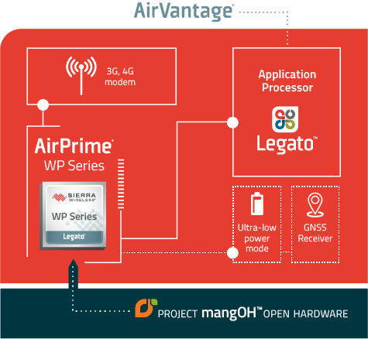

AirPrime® WP Series Cellular Modems
Features and Benefits
ARM core application processor with dedicated Flash and RAM running Legato™ enhances security, reduces system complexity, and lowers overall BOM (bill of materials)
GNSS receiver enables tracking and location-based services
Ultra-low power mode reduces power consumption by 200x for battery or solar powered applications
Compact CF3™ form factor with solder-down or snap-in socket options for ultimate flexibility in prototyping and build-to-order manufacturing
Secure boot and value-add firmware with FREE unlimited firmware over-the-air (FOTA) upgrades for the lifetime of the module to keep the connectivity optimized and secure
Interfaces include USB, UART, SDIO, HSIC, I2C, SPI, GPIO, ADC, PCM, and more
Open hardware reference design from Project mangOH™, enables rapid prototyping with industrial-grade components to get you to market faster
Secure device-to-cloud architecture with AirVantage® pre-integrated into the Legato platform

Slide 16
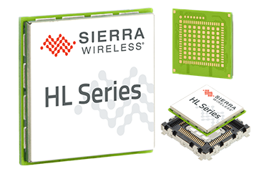
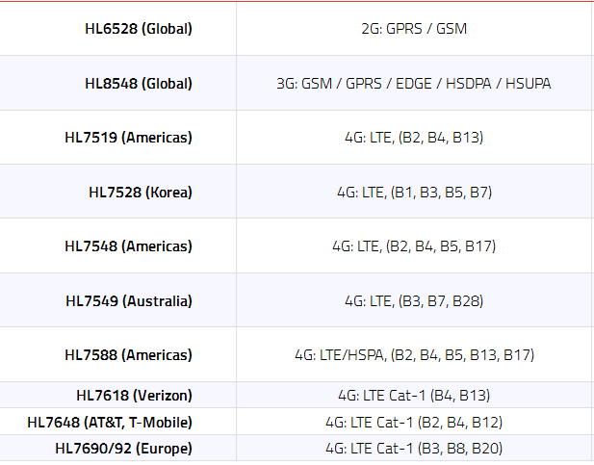
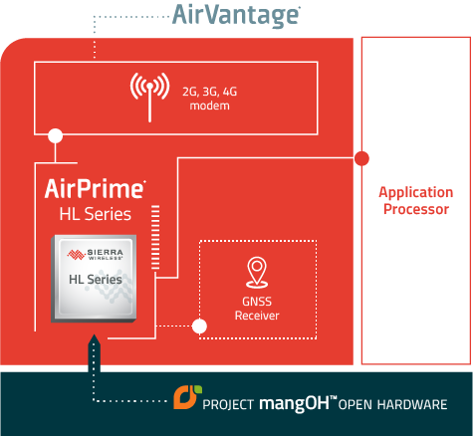
AirPrime® HL Series
Feature and Benefits
Global coverage on a single module (2G/3G variants) with industry and mobile network certifications to get you to market faster
GNSS receiver (2G/3G variants) enables tracking and location-based services
Compact CF3™ form factor with solder-down or snap-in socket options for ultimate flexibility in prototyping and build-to-order manufacturing
Secure boot and value-add firmware with FREE unlimited firmware over-the-air (FOTA) upgrades for the lifetime of the module to keep the connectivity optimized and secure
Interfaces include SIM, UART, USB, ADC, GPIO, flash LED output, PWM (buzzer), and Tx BURST indicator

Slide 17
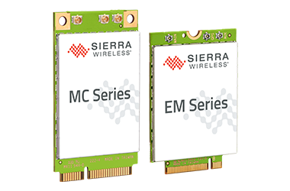
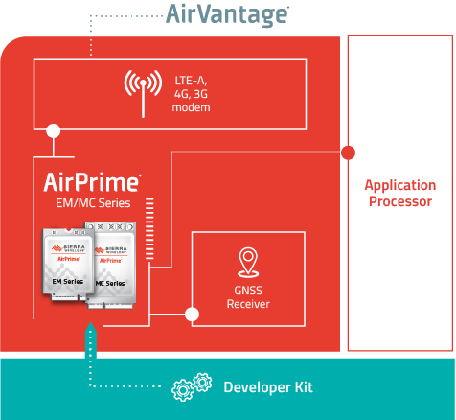
AirPrime® EM/MC Series
Global coverage on LTE-Advanced networks with only 2 module variants to easily expand into new markets (North America/Europe SKU; Asia Pacific SKU)
Switch networks anytime with up to three different certified firmware variants on board*
Comprehensive GNSS coverage with GPS, GLONASS, Beidou, and Galileo satellite system support enabling tracking and location-based services
Secure boot and value-add firmware with FREE unlimited firmware over-the-air (FOTA) upgrades for the lifetime of the module to keep the connectivity optimized and secure**
Interfaces include SIM, USB, PCM/I2S, GPIO, flash LED output, and more
* 74xx feature, 73xx can switch networks over-the-air via host server**native FOTA support for 74xx; 73xx supported via Linux SDK

Slide 18
WP Series Overview
ARM core application processor with dedicated Flash and
RAM running Legato™
GNSS receiver enables tracking and location-based
services Ultra-low power mode
Compact CF3™ form factor
Secure boot and value-add firmware with
FREE unlimited firmware over-the-air (FOTA) upgrades
Interfaces include USB, UART, SDIO, HSIC, I2C, SPI, GPIO, ADC, PCM, and more
Open hardware reference design from Project mangOH™
Secure device-to-cloud architecture with AirVantage® pre-integrated into the Legato platform
Product Options | WP8548 | 3G: HSPA+ / EDGE / GPRS / GSM | Support and Technical Resources
 | WP75xx | 4G: LTE / HSPA+ / EDGE / GPRS / GSM | Technical resources available soon
Notes:
ARM core application processor with dedicated Flash and RAM running Legato™ enhances security, reduces system complexity, and lowers overall BOM (bill of materials)
GNSS receiver enables tracking and location-based services
Ultra-low power mode reduces power consumption by 200x for battery or solar powered applications
Compact CF3™ form factor with solder-down or snap-in socket options for ultimate flexibility in prototyping and build-to-order manufacturing
Secure boot and value-add firmware with FREE unlimited firmware over-the-air (FOTA) upgrades for the lifetime of the module to keep the connectivity optimized and secure
Interfaces include USB, UART, SDIO, HSIC, I2C, SPI, GPIO, ADC, PCM, and more
Open hardware reference design from Project mangOH™, enables rapid prototyping with industrial-grade components to get you to market faster
Secure device-to-cloud architecture with AirVantage® pre-integrated into the Legato platform

Slide 19

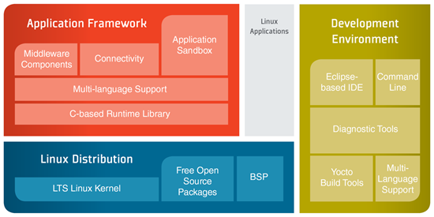
Legato™ Embedded Platform
Developing immediately with Legato pre-integrated, tested, and validated inside the application processors of AirPrime WP Series and AR Series.

Slide 20
